Slide 1
CSCI-P 532 Object Oriented Software Development
Team 2 – Assignment 5
Ethan T. Behar
Pratyush Duklan
Snehal Patare
Luddy School of Informatics, Computing, and Engineering
INDIANA UNIVERSITY BLOOMINGTON
Notes:
The main goal of my thesis is to find the applicability of high performance computing principles and algorithms in modern end to end deep learning solutions.
With adoptation of deep learning in many areas it is important to have highy efficient frameworks that handle both data processing and deep learning

Slide 2
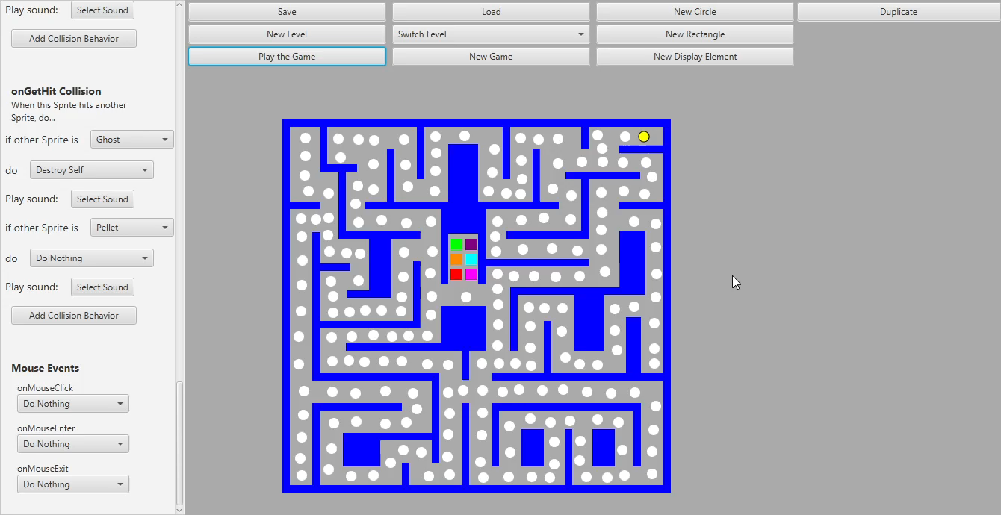
Demo
Notes:
Performance for both data processing and deep learning
ease of use is as important as performance if any framework is to be adopted by the community

Slide 3
Architecture
MVC Pattern
  Still has issues reported from our code review
    Mainly model, view, controller logic was mixed in various places.
  Regardless, still able to implement new QoL improvements
  Adding game logic functionality was easy but a bit tedious
Composite Pattern
  Leverage JavaFX
    Really made adding to the UI effortless
  Saving/Loading
    Tedious because of 5 different files have to be updated
Observer Pattern
  UI Observers selected sprite to update data immediately
  Sprites observe game loop so they can update every tick
Strategy Pattern
  Used for buttons in the UI
  Used for events and actions in the game
Notes:
Performance for both data processing and deep learning
ease of use is as important as performance if any framework is to be adopted by the community

Slide 4
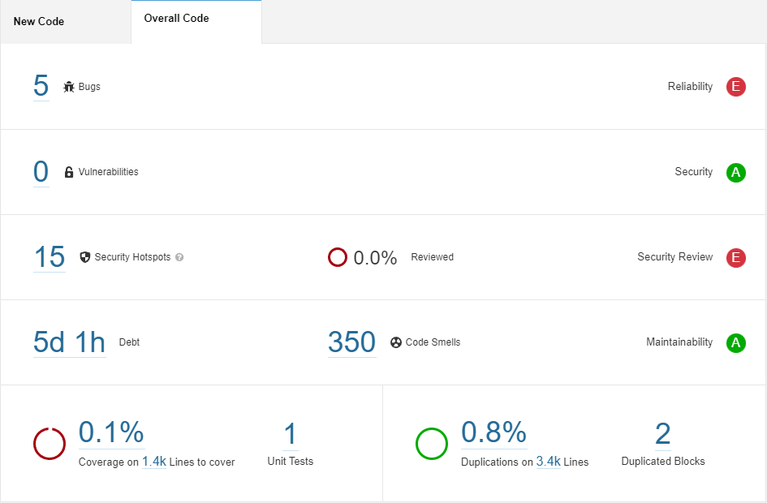
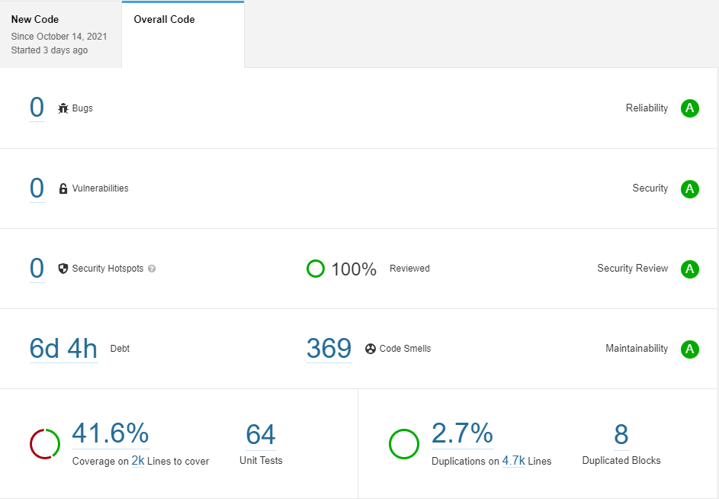
SonarQube Report
Notes:
Performance for both data processing and deep learning
ease of use is as important as performance if any framework is to be adopted by the community

Slide 5
Teamwork
Communication was great.
Merged into development daily.
  Merged development into personal branches before merging into development branch.
    Localized merge conflicts to personal branches
    instead of development branch.
New strategy: Resident Experts
  Ethan – Adding Game Logic
  Pratyush – AddingTests
  Snehal – Working with Bamboo and SonarQube
  Allowed one individual to focus on a task and become proficient in it.
    When task was completed, we moved to other areas to help out.
    “Resident Expert” explained current situation and current tasks.
Notes:
Performance for both data processing and deep learning
ease of use is as important as performance if any framework is to be adopted by the community

